Slide 1

Tchalins JEUDY
Customer Churn Analysis

Slide 2
Problem
Describe the business problem and define the analytic approach to solving the problem.
What is the business problem?
Rep:
Unsubscribing is a crucial problem for the Telco company, a large part of the clientele leaves us for other companies..
Who are the stakeholders impacted by the problem?
Rep:
The company is the main deficit in this problem.

Slide 3
Problem
Why is this problem important to the organization?
Rep:
it is a big problem for the business if customers start unsubscribing it will cause it to go bankrupt which could cause damage to the business.

Slide 4
Methodology
We performed a univariate analysis of the Churn variable, and a bivariate analysis of the latter by each of the other variables using python language tools for data Scientist which does statistical analysis and visualization.

Slide 5
Results
1.1-How much is churn affecting the business?
1.2-How big is churn compared to the existing customer base?
2.-Explain churn by the below categories. Are there any factors that combine to be especially impactful?
Customer demographics like age and gender
Services used
Billing information.
3.1-What services are typically purchased by customers who churned?
3.2- Are any services especially helpful in retaining customers?

Slide 6
Results
4. Are there types of people who churn at higher rates?
5. A case study for one of a customer profiles. How much additional revenue we could make by increasing sales by 10% in that profile.

Slide 7
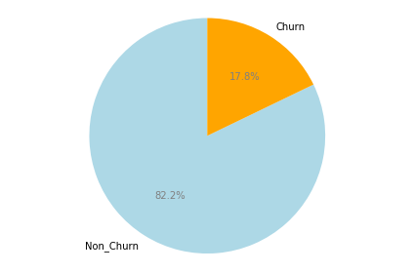
1.1-How much is churn affecting the business
The business is affected by a 17.8% loss of incomes this month
based on the proportion of total charges represented by the churners.

Slide 8
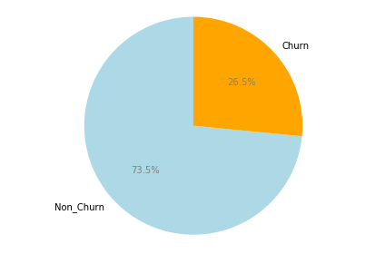
1.2-How big is churn compared to the existing customer base
Compared to the existing consumer base, churners represent 26.5%,

Slide 9
2.-Explain churn by the below categories.
(Demographics)
The unsubscriber appears not to be greatly influenced by gender
and don't have a partner but more with to be a senior citizen and be dependent.

Slide 10
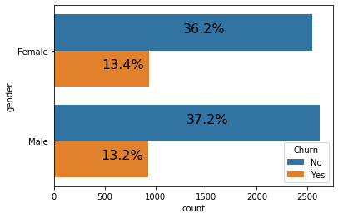
Explain churn by gender
The gender of the clients which is binary, i.e. Male and Female
is not significant for churners
as it is approximately equal for churners and loyal clients.

Slide 11
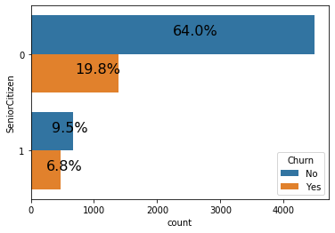
Explain churn by Senior Citizen
Senior Citizen is binary and really significant.
Minor are proportionally more loyal than senior
because in relation to our database of 7000 clients,
we have a rate of 19.8% minor churn for 64%minor no-churn
versus 6.8% senior churn for 9.5% senior no-churn.

Slide 12
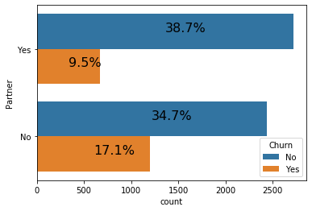
Explain churn by Partner
Have a partner is also binary,
it is not significant for churners
as it is also approximately equal for churners and loyal clients.

Slide 13
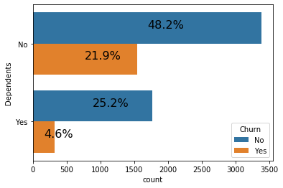
Explain churn by Dependents
Being dependent is binary and significant.
Dependent customers are more loyal than non-dependent customers
because we have a higher probability for dependents to be more loyal
and also by analyzing the proportions in our database of 7000 customers,
we have a rate of 4.6% churn for 25.2% of no-churn dependents
versus 21.9% of churn for 48.2% of no-churn of no-dependent.

Slide 14
2.-Explain churn by the below categories.
(Service Used)
The unsubscriber seems to be greatly influenced by what type of service for all types of services.

Slide 15
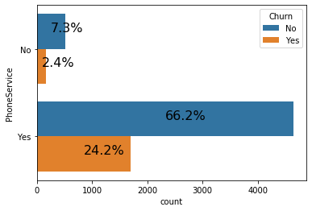
2.-Explain churn by Phone Service
The most significant and most used service from which other services such as Multiplelines are derived and from which it is important to continuously improve quality.

Slide 16
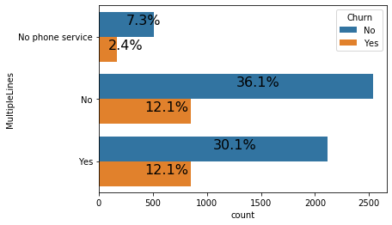
2.-Explain churn by Multiple lines
Derived from the Phone service,
Multiplelines is a service that is not significant
for determining Churn because the values of those who use it
and churn are approximately equal to those who
use it and do not churn.

Slide 17
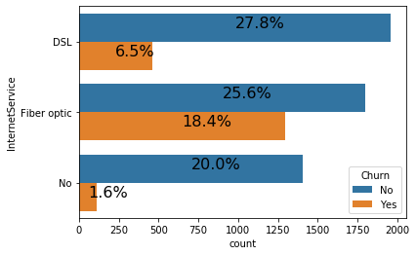
2.-Explain churn by Internet Service
The internet service is a very used service that offers a fiber optic service and a DSL service
that share almost the same amount of loyal customers
but with a very big difference with the churn
because they are mainly concentrated in the fiber optic
which implies beyond the statistical tests
a very high significance with the churn.

Slide 18
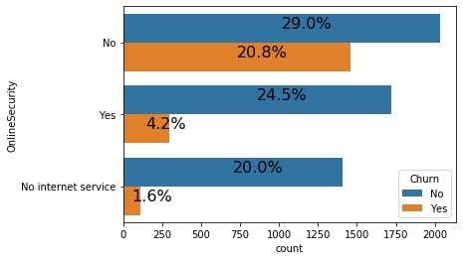
2.-Explain churn by Online Security
Derived from the Internet service,
the Online Security service is a significant service for determining churn
because customers using the Internet service who do not use Online Security
are much more likely to churn than those using it.

Slide 19
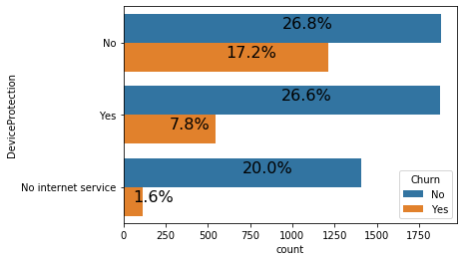
2.-Explain churn by Device Protection
The Device Protection is very significant for determining churn
because having almost the same amount of loyal customers between
those who use the internet service but do not use the device protection,
there is a very big difference in churn
because they churn much less when they use the device protection.

Slide 20

2.-Explain churn by Tech Support
Tech support is also very significant in determining churn
because those who use the internet service without using tech support
have almost half the churn, while those who use it are very few in churn.

Slide 21
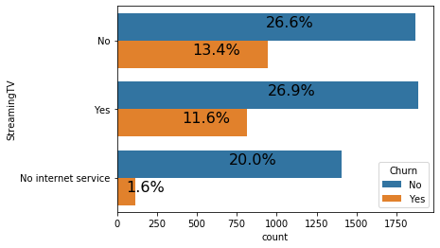
2.-Explain churn by StreamingTv
Streaming Tv is not significant for determining churners
as it is approximately equal for churners and loyal clients
so a client who use internet service.
a customer who uses internet service
does not necessarily need to use Streaming Tv for churn.

Slide 22
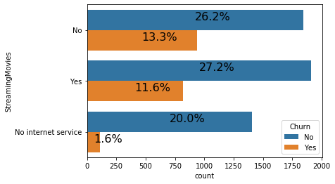
2.-Explain churn by the Streaming Movies
Streaming Movies is not neither significant for determining churners
as it is approximately equal for churners and loyal clients
so a client who use internet service.
a customer who uses internet service
does not necessarily need to use Streaming Movies for churn.

Slide 23
2.-Explain churn by the below categories.
(Billing Information)
The unsubscriber seems to be greatly influenced by billing information.

Slide 24
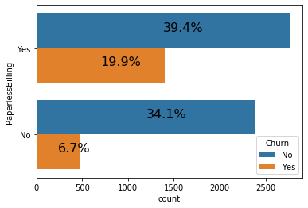
2.-Explain churn by the Paperless Billing
Paperless billing is very significant to determine the churner
because it is shown in the associated graph that
the churners are much more numerous to use paperless billing
than those who do not use it.

Slide 25
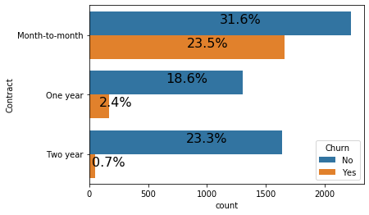
2.-Explain churn by Contract
The churners are greatly influenced by the type of contract,
looking at the associated graph, we see that the churner is more likely to churn for a monthly contract than for a yearly contract and even less so for a two-year contract.

Slide 26
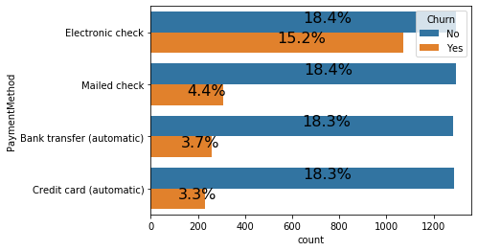
2.-Explain churn by Method
The Payment method explains a lot of the churn especially for those who use the electronic method because almost half of the clients who have used this method have churn.

Slide 27
3.1- Services are typically purchased by customers who churned
Services most used by churn customers are Internet and Phone

Slide 28
Internet Service is typically purchased by customers who churned
The internet service is one of the services that churners buy the most,
it has two types: DSL and the Fiber optic service,
the Fiber optic service is a service that does not work well
because on our database of 7000 customers,
20 % did not have the internet service and stayed,
1.6% did not have it and left
but 25.6% had fiber optic and remained loyal against
18. 4% who had it and are gone,
27.8% had the DNL and stayed
6.5% had it and are gone

Slide 29
Phone Service is typically purchased by customers who churned
Online Backup is also one of the services that churners buy the most,
it has one of the highest churn rates and the most used
compared to our database of almost 7000 customers,
7.3% did not have this service and stayed,
2.4% did not have it and left
and 66.2% got it and stayed loyal compared to
but 24.2% who got it and left.

Slide 30
3.2- Services especially helpful in retaining customers
Online Support, online security, online protection and tech support fidelize client.

Slide 31
Fidelize Client with Tech Support
Technical support is a service derived from internet service,
but internet service is one of the services that churners buy the most
or technical support has on our database of nearly 7000 customers
28.8% have not had this service and stayed,
20.6% did not have it and left
but 24.6% had it and remained faithful against
only 4.4% who had it and left.

Slide 32
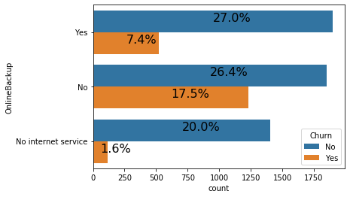
Fidelize Client with Online Backup
Online Backup is also a service derived from internet service,
he is very important and helps to retain customers
because on our database of almost 7000 customers
26.4% did not have this service and stayed,
17.5% did not have it and left
but 27% got it and stayed loyal compared to
only 7.4% who got it and left.

Slide 33
Fidelize Client with Online Security
Online Security is also a service derived from internet service,
he is very important and helps to retain customers
because on our database of almost 7000 customers
29 % did not have this service and stayed,
20.5% did not have it and left
but 24.5% got it and stayed loyal compared to
only 4.2% who got it and left.

Slide 34
Fidelize Client with Device Protection
Device Protection is also a service derived from internet service,
he is very important and helps to retain customers
because on our database of almost 7000 customers
26.8% did not have this service and stayed,
17.2% did not have it and left
but 26.6% got it and stayed loyal compared to
only 7.8% who got it and left.

Slide 35
4.-Types of people who churn at higher rates
The typical churner can be a man or a woman because gender has very little influence on churn and other variables

Slide 36
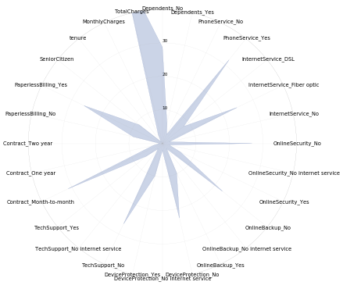
Typical profile of a churner
Yvel :
The typical churner can be a man or a woman
Dependents_No
SeniorCitizen_Yes
PhoneService_Yes
InternetService_Fiber optic
OnlineSecurity_No
OnlineBackup_No
DeviceProtection_No
TechSupport_No
Contract_Month-to-month
PymentMethod_Electronic check
PaperlessBilling_Yes
tenure=17.004260 by mean
monthly charge=74.812087 by mean
total charge=1440.979499 by mean
and order variables are not important to determine it.

Slide 37
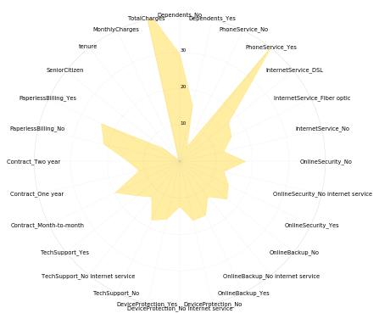
Typical profile of the loyal customer
Morgan :
The typical loyal customer can be a man or a woman
Dependents_No
SeniorCitizen_No
PhoneService_Yes
InternetService_DSL
OnlineSecurity_No
OnlineBackup_Yes
DeviceProtection_Yes
TechSupport_No
Contract_Month-to-month
PaymentMethod_Credit Card
PaperlessBilling_Yes
tenure=37.933176 by mean
monthly charge=61.674941 by mean
total charge=2594.054422 by mean
and order variables are not important to determine it.

Slide 38
5.- Case study for one of our customer profiles
How much additional revenue you could make by increasing sales by 10% in that profile.

Slide 39
Case study for the loyal customer (Morgan)
With an average revenue of 2594.054422 for the loyal customer profile, a 10% increase in sales implies an additional revenue of 259.40544220000004.

Slide 40
Discussion & Recommendations
Make Yvel enjoy the same benefits as Morgan.

Slide 41
Proposed solution
The aim of the work is to find a solution to the problem of customers leaving the company. Based on profile, we propose the business solution which involves making decisions that will make the churner customer feel like a loyal customer.
Make Yvel enjoy the same benefits as Morgan.

Slide 42
Decisions
Encourage SeniorCitizen and Dependent_no by improving the Phone Service and also a big improvement of the Fiber Optic or make them switch to DSL.
Offering them also as Online Backup, Tech Support, a one or two year contract, while decreasing their Monthly Charge by 13, which can increase their tenure by 10 or 11 and their TotalCharges by 1,153.
Encourage SeniorCitizen
Encourage Dependent_no
Improving the Phone Service
Big improvement of the Fiber Optic or make them switch to DSL.
Offering them Online Backup
Offering them Tech Support
Disencouraging payment by Electronic check
Offering them a one or two year contract
Decreasing Monthly Charge by 13 an average

Slide 43
Strengths of the organization
The company is a company that sets an example on gender equality, the status of a customer is not related to his gender and also less on his social status (Dependent), especially encourages young people and has a very good streaming service.

Slide 44
Weaknesses of the organization
The company disadvantages the SeniorCitizen, the fiber optic service is of very poor quality, does not offer the services derived from the Internet service to everyone, has an unbalanced monthly contract for the customer and a payment by electronic check that does not inspire confidence.

Slide 45
Challenges that you might encounter
Senior Citizens are more reluctant to use new technologies but customers who use electronic invoicing can very often be the victim and additional services will bring an additional cost while we want to reduce monthly charges.
How can you mitigate them
Develop a platform (app or web site) for very simple customers that will allow Senior citizens to use new technologies and that will allow customers to pay their electronic invoices in complete security, and also to put additional services at a lower cost which will increase TotalCharges in the long term.

Slide 46
References & Appendices
Data: https://www.kaggle.com/blastchar/telco-customer-churn/data#
Notebook:

